Slide 1
Electronics Lab (Experiment-4)
C. Pranav Vignesh Roll no : 21IE10011
P . Manoj Kumar Roll no : 21IE10027
Bibhujit Nayak Roll no : 21IE10046

Slide 2
Objective of The Experiment
To design a common collector amplifier
To simulate and observe performance of the CC amplifier
To design a directly coupled CE-CC amplifier
To observe advantages of CE-CC amplifier w.r.t a CE amplifier through simulation
To observe limitation of power efficiency of a class A amplifier

Slide 3
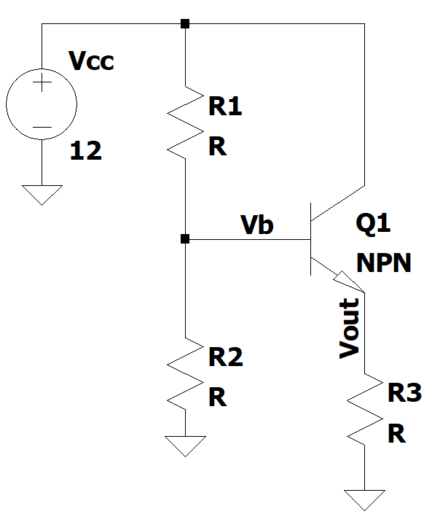
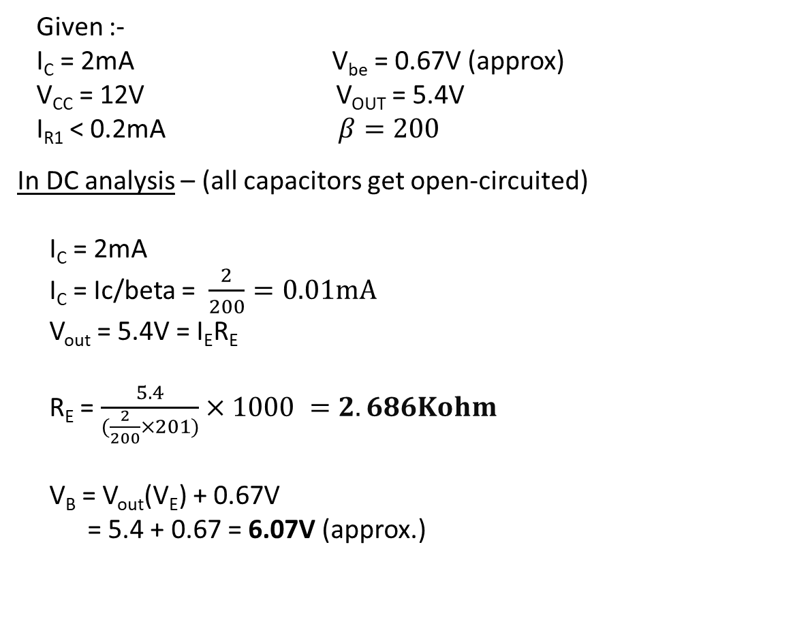
CALCULATIONS
Given :-
I_{C} = 2mA V_{be} = 0.67V (approx)
V_{CC} = 12V V_{OUT} = 5.4V
I_{R1} < 0.2mA $β=200$
In DC analysis – (all capacitors get open-circuited)
I_{C} = 2mA
I_{C} = Ic/beta = $\frac{2}{200}=0.01mA$
V_{out} = 5.4V = I_{E}R_{E}
R_{E} = $\frac{5.4}{(\frac{2}{200}×201)}×1000 =2.686Kohm$
V_{B} = V_{out}(V_{E}) + 0.67V
= 5.4 + 0.67 = 6.07V (approx.)

Slide 4
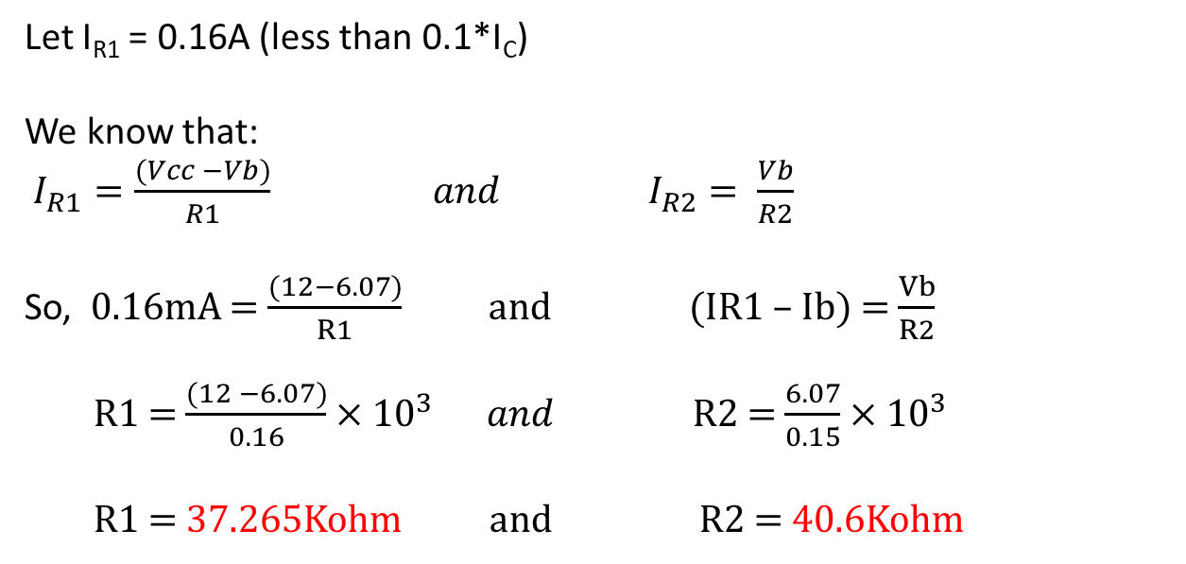
CALCULATIONS
Let I_{R1} = 0.16A (less than 0.1*I_{C})
We know that:
$I_{R1}=\frac{(Vcc −Vb)}{R1} and I_{R2}= \frac{Vb}{R2}$
So, 0.16mA = $\frac{(12−6.07)}{R1}$ and (IR1 – Ib) = $\frac{Vb}{R2}$
R1 = $\frac{(12 −6.07)}{0.16}×{10}^{3} and$ R2 = $\frac{6.07}{0.15}×{10}^{3}$
R1 = 37.265Kohm and R2 = 40.6Kohm
R1 = 37.265Kohm R2 = 40.6Kohm R3 = 2.686Kohm

Slide 5
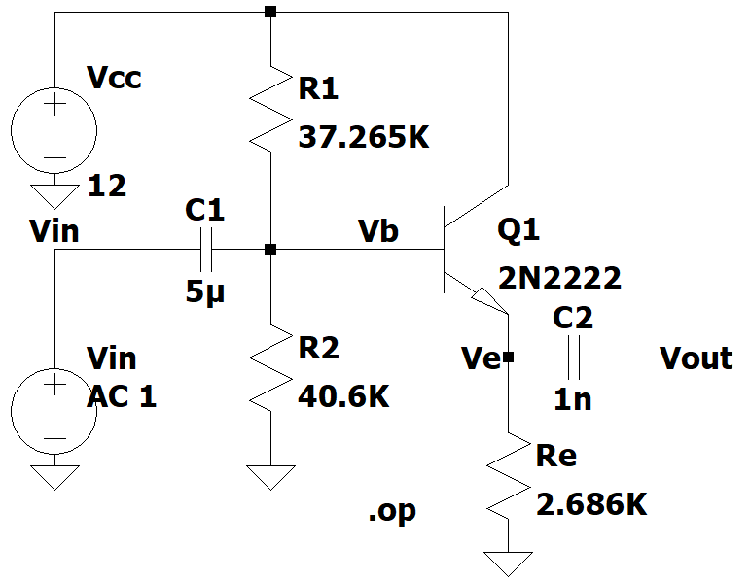
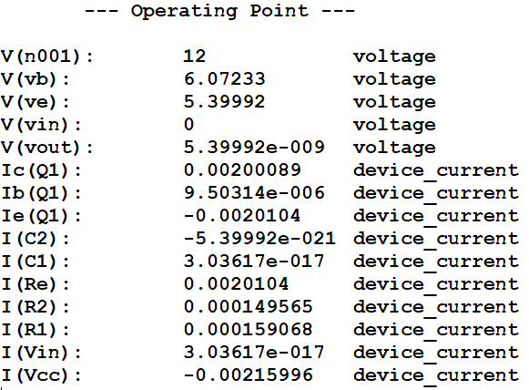
Part A : Circuit Diagram
Fig-1.1-Circuit Diagram for Common Collector Configuration having 1nF load and DC operating analysis of the circuit I_{C}=2mA ,I_{R1}=0.16mA, V_{E}=5.4V

Slide 6
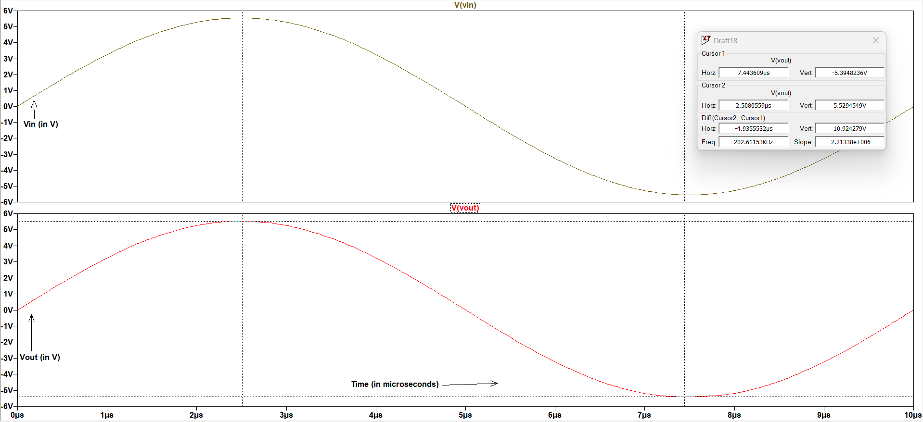
Maximum Output Swing
Fig-1.2-Maximum output swing obtained without distortion in the Common collector Amplifier
The maximum peak to peak voltage at output was found to be 10.924V , when the circuit is excited with a input signal of 11.1V(p-p) and frequency 100KHz .

Slide 7
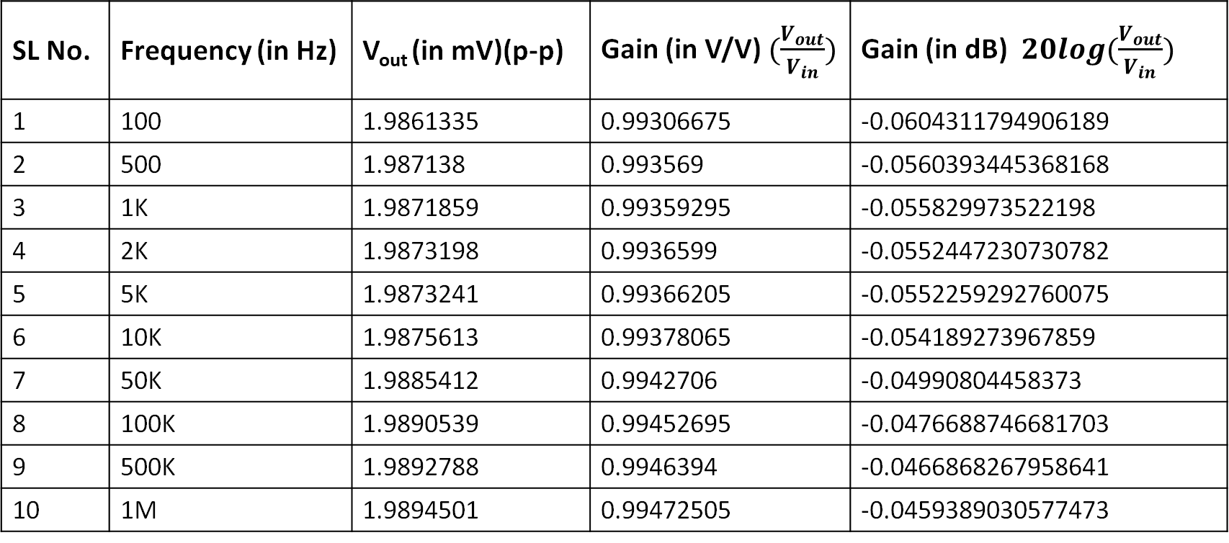
Gain Calculation from Transient Analysis
Gain is calculated from transient analysis when the input is 2mV (p-p) and frequency is varied .
SL No. | Frequency (in Hz) | V_{out} (in mV)(p-p) | Gain (in V/V) $(\frac{V_{out}}{V_{in}})$ | Gain (in dB) $20log(\frac{V_{out}}{V_{in}})$
1 | 100 | 1.9861335 | 0.99306675 | -0.0604311794906189
2 | 500 | 1.987138 | 0.993569 | -0.0560393445368168
3 | 1K | 1.9871859 | 0.99359295 | -0.055829973522198
4 | 2K | 1.9873198 | 0.9936599 | -0.0552447230730782
5 | 5K | 1.9873241 | 0.99366205 | -0.0552259292760075
6 | 10K | 1.9875613 | 0.99378065 | -0.054189273967859
7 | 50K | 1.9885412 | 0.9942706 | -0.04990804458373
8 | 100K | 1.9890539 | 0.99452695 | -0.0476688746681703
9 | 500K | 1.9892788 | 0.9946394 | -0.0466868267958641
10 | 1M | 1.9894501 | 0.99472505 | -0.0459389030577473

Slide 8
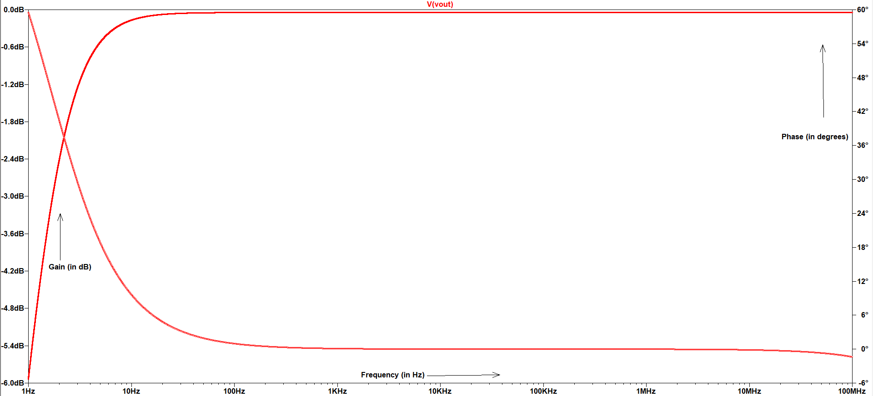
Gain and Phase Response of the CC Amplifier
Fig-1.3-Frequency Response of the common collector amplifier
The maximum gain(in dB) and upper cut frequency is given below.
max_gain: MAX(mag(v(vout)))=(-0.0444134dB,0°) FROM 1 TO 1e+008
f1: mag(v(vout))=max_gain/sqrt(2) AT 1.69716

Slide 9
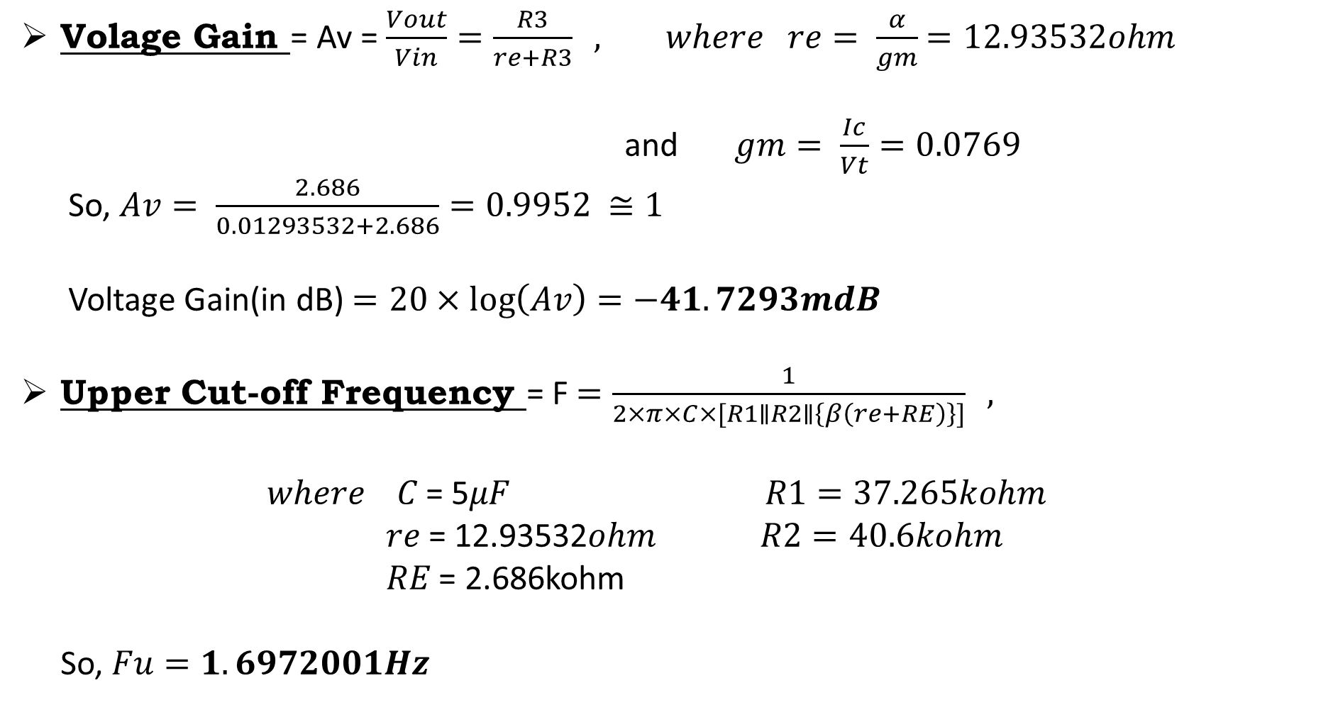
Calculation of Gain and Upper cut-off Frequency

Slide 10
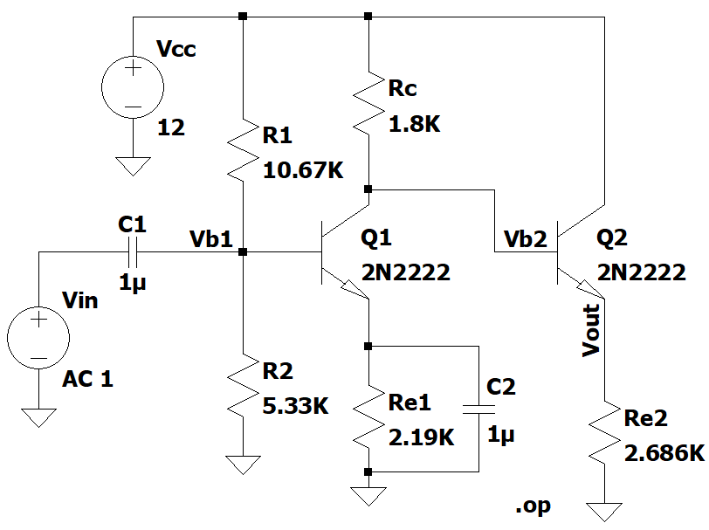
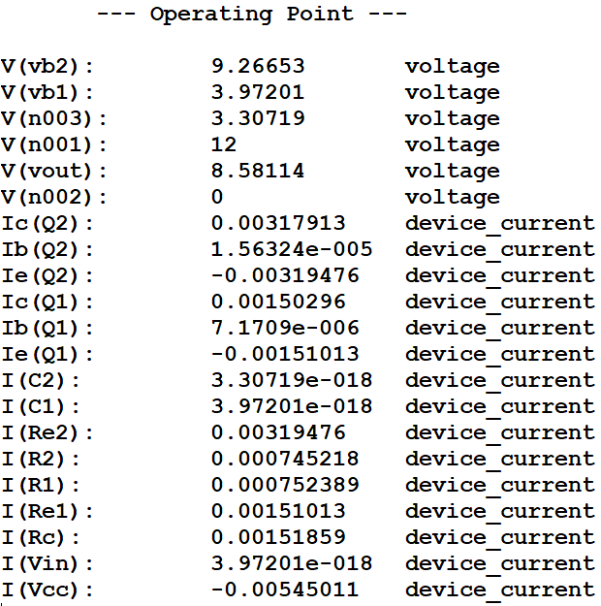
Part B : Circuit Diagram
Fig-2.1-Circuit Diagram of Cascaded CE-CC amplifier and DC operating point analysis of the circuit

Slide 11
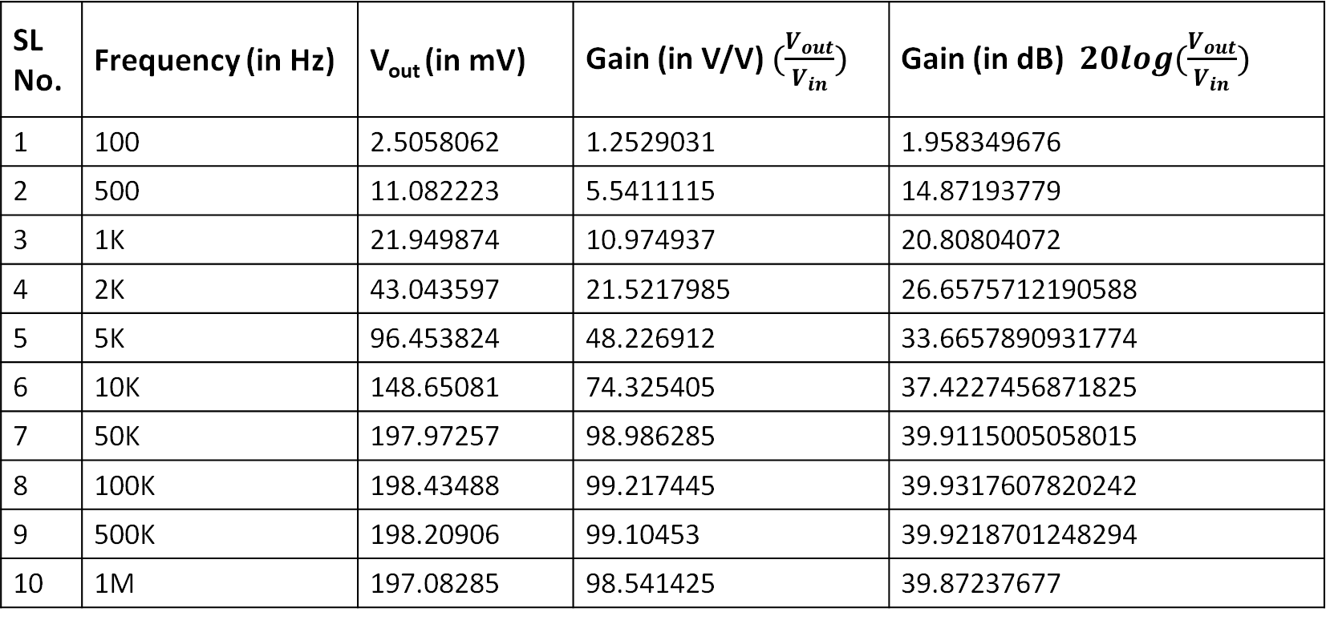
Gain Calculation from Transient Analysis
Gain is calculated from transient analysis when the input is 2mV (p-p) and frequency is varied .
SL No. | Frequency (in Hz) | V_{out} (in mV) | Gain (in V/V) $(\frac{V_{out}}{V_{in}})$ | Gain (in dB) $20log(\frac{V_{out}}{V_{in}})$
1 | 100 | 2.5058062 | 1.2529031 | 1.958349676
2 | 500 | 11.082223 | 5.5411115 | 14.87193779
3 | 1K | 21.949874 | 10.974937 | 20.80804072
4 | 2K | 43.043597 | 21.5217985 | 26.6575712190588
5 | 5K | 96.453824 | 48.226912 | 33.6657890931774
6 | 10K | 148.65081 | 74.325405 | 37.4227456871825
7 | 50K | 197.97257 | 98.986285 | 39.9115005058015
8 | 100K | 198.43488 | 99.217445 | 39.9317607820242
9 | 500K | 198.20906 | 99.10453 | 39.9218701248294
10 | 1M | 197.08285 | 98.541425 | 39.87237677

Slide 12
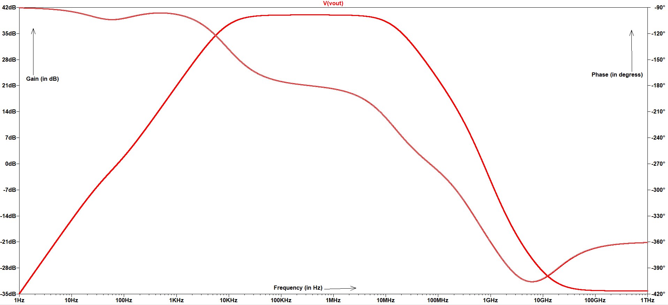
Gain and Phase response of CE Amplifier
Fig-2.2-Frequency Response of the common emitter amplifier
The maximum gain(in dB) and upper cut frequency is given below.
max_gain: MAX(mag(v(vout)))=(39.9987dB,0°) FROM 1 TO 1e+012
f1: mag(v(vout))=max_gain/sqrt(2) AT 8996.15

Slide 13
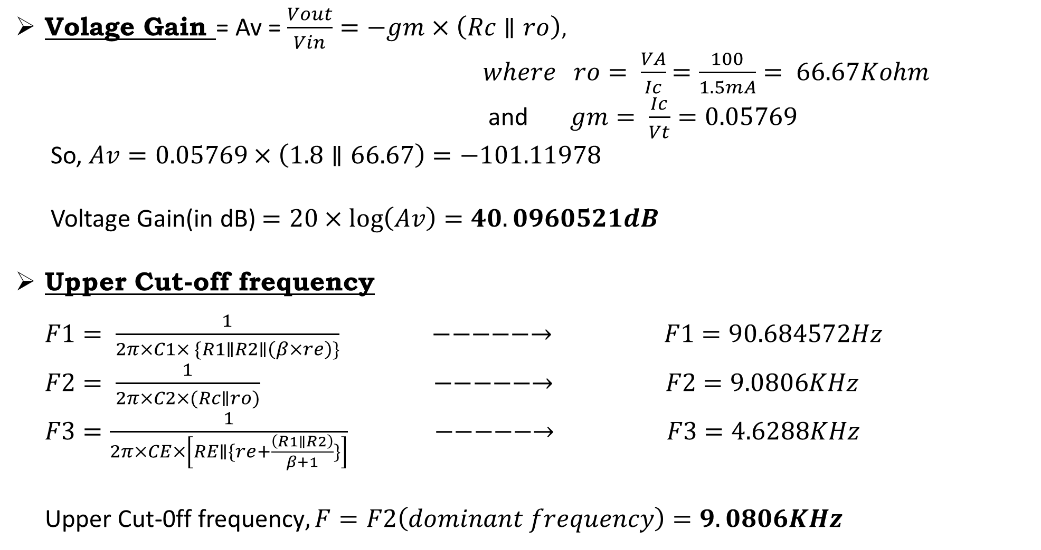
Calculation of Gain and Upper cut-off Frequency (CE amplifier)
Substituting values of resistors and capacitors

Slide 14
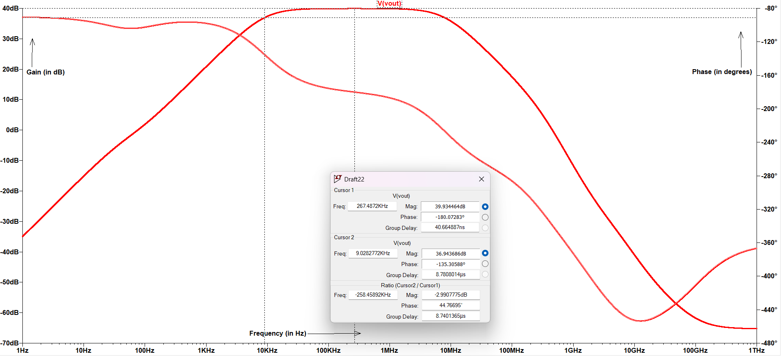
Gain and Phase response of cascaded Amplifier
Fig-2.3-Frequency Response of the cascaded CE-CC amplifier
The maximum gain(in dB) and upper cut frequency is given below.
max_gain: MAX(mag(v(vout)))=(39.9345dB,0°) FROM 1 TO 1e+012
f1: mag(v(vout))=max_gain/sqrt(2) AT 8987.78

Slide 15
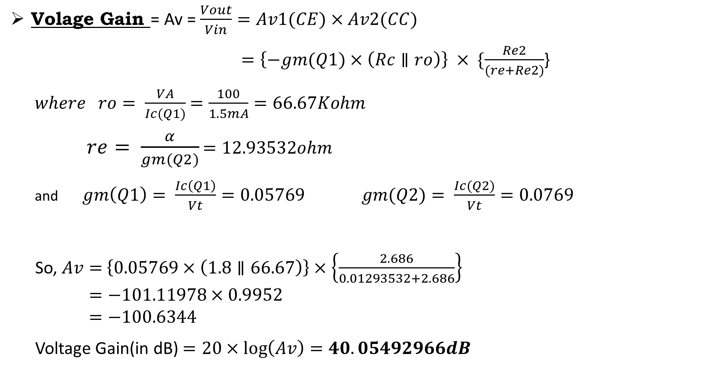
Calculation of Gain and Upper cut-off Frequency (CE-CC amplifier )

Slide 16
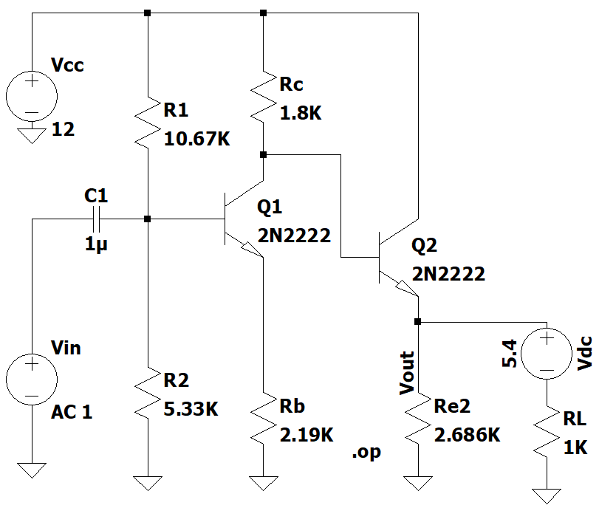
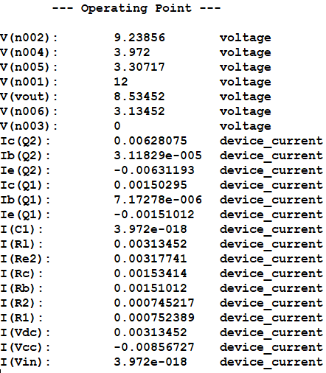
Part C : Circuit Diagram
Fig-3.1-Circuit Diagram of the Cascaded CE-CC amplifier with driving resistive load and the DC operating point analysis of the circuit

Slide 17
Change in Operating Point
The change in operating point parameters were observed for both the amplifiers i.e. cascaded CE-CC amplifier and cascaded amplifier with driving resistive load . There is a significant increase in the collector current in the CC stage.
Operating point Parameters | CE-CC multistage amplifier | CE-CC amplifier with driving a resistive load
V_{ce}(Q1) | 5.96V | 5.93V
I_{C}(Q1) | 1.5mA | 1.5mA
V_{ce}(Q2) | 3.42V | 3.47V
I_{C}(Q2) | 3.18mA | 6.28mA
V_{out}(Q2) | 8.58114V | 8.53452V

Slide 18
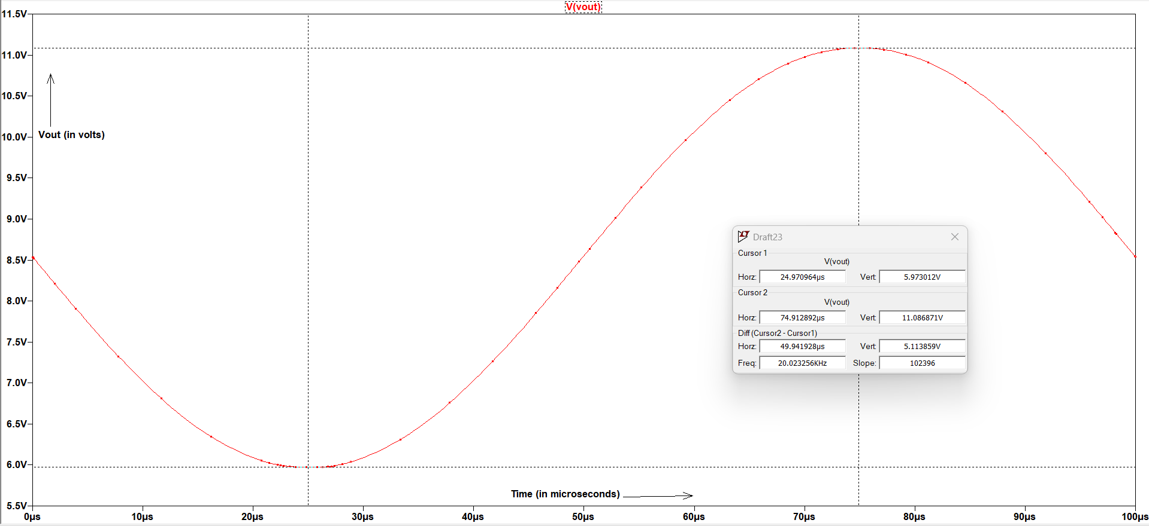
Maximum Output Swing
Fig-3.2-Maximum output swing obtained without distortion in the Amplifier
The maximum peak to peak voltage at output was found to be 5.1138V , when the circuit is excited with a input signal of 6.5V(p-p) and frequency 10KHz .

Slide 19
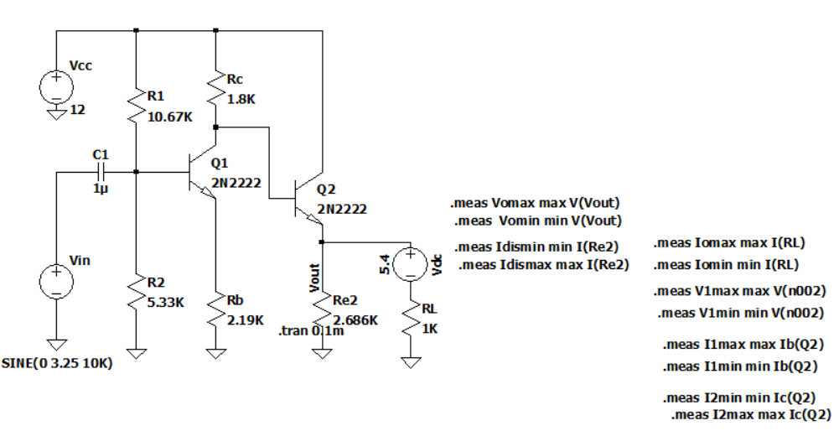
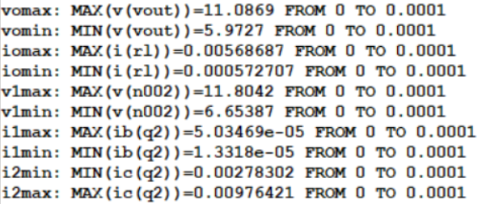
Power Calculation (Circuit Diagram and Measured Values
Fig-3.3-Circuit Diagram of Cascaded Amplifier Circuit with driving resistive load and Measured Values

Slide 20
Calculation
The output signal is the AC power dissipated across R_{L} and the DC voltage source
This is given by P_{signal}=((V_{omax} - V_{omin} )*(I_{omax} - I_{omin} )/8) = 3.27 mW
Now to find power dissipated we can find the power dissipated across the resistive load of the CC amplifier. Here we include both the AC and DC components .So it is given by,
P_{dissipated}=((V_{omax} - V_{omin} )/2)²)/2R_{e2})+((V_{omax} + V_{omin} /2)²/2R_{e2}) = 29.52 mW

Slide 21
Calculation
Now to calculate efficiency of CC part we can use
Efficiency = (1-(P_{dissipated}/P_{supplied}))*100%
P_{supplied} = Power from V_{CC} + Power from input signal
Neglecting Power from input as it is small compared to Power from V_{CC}
We get P_{supplied} = V_{CC}*((I_{2max} + I_{2min} )/2)=75.24 mW
Therefore,
Efficiency of CC part = (1-(P_{dissipated}/P_{supplied}))*100%
= 60.76%

Slide 22
Observations
The common-collector amplifier acts as an buffer circuit that gives very high input impedance, which can be used to avoid loading effects in amplifiers.

Slide 23
Thank You !

